Slide 1
Predicting Ski Resort
Weekend Ticket Prices Using
Machine Learning
Brittany Barrion
Springboard Data Science Career Track
Guided Capstone Project

Slide 2
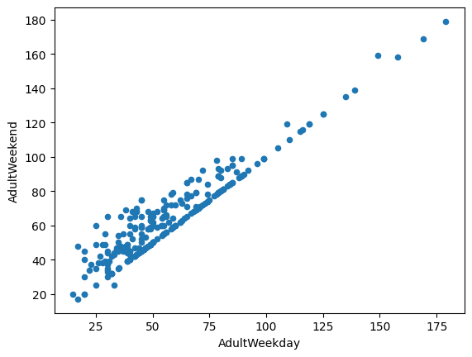
Problem Statement & Data Preparation
Business Problem
Predict adult weekend ticket prices
Identify the resort features that most affected pricing
Support better pricing decisions with machine learning
Data Wrangling
Started with data from 330 US ski resorts
Corrected missing and inaccurate values
Removed duplicate and incomplete records
Added state demographic data
Created engineered features for modeling

Slide 3
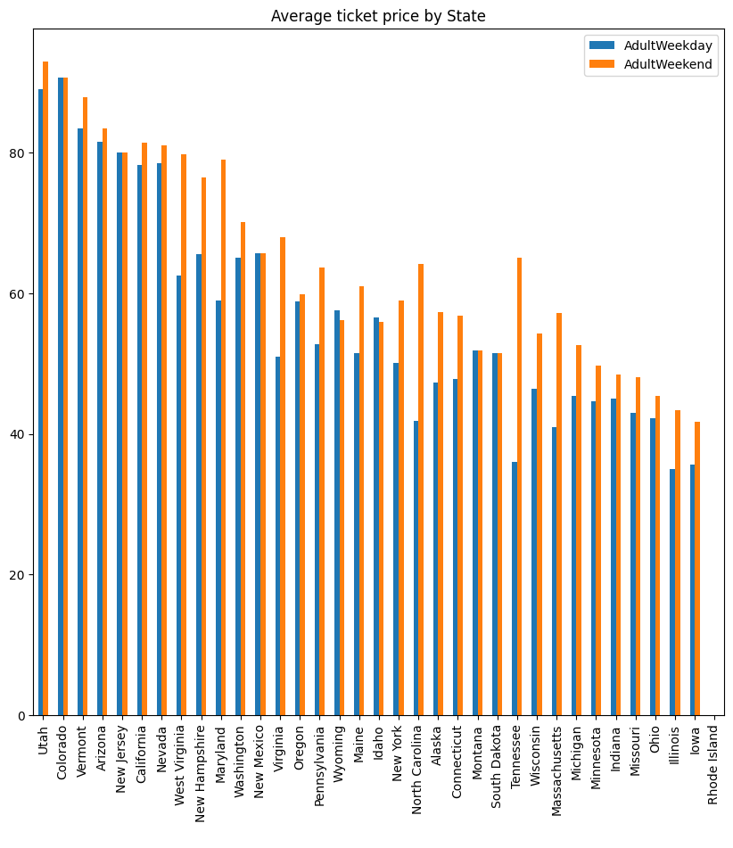
Key Findings & Business Recommendation
Key Findings
Weekend prices exceeded weekday prices
Western states generally had the highest average weekend ticket prices
Pricing varied significantly by location
Recommendations
Increased ticket prices gradually while continuing to invest in resort improvements. The model indicates these enhancements support higher pricing potential and increased seasonal revenue.

Slide 4
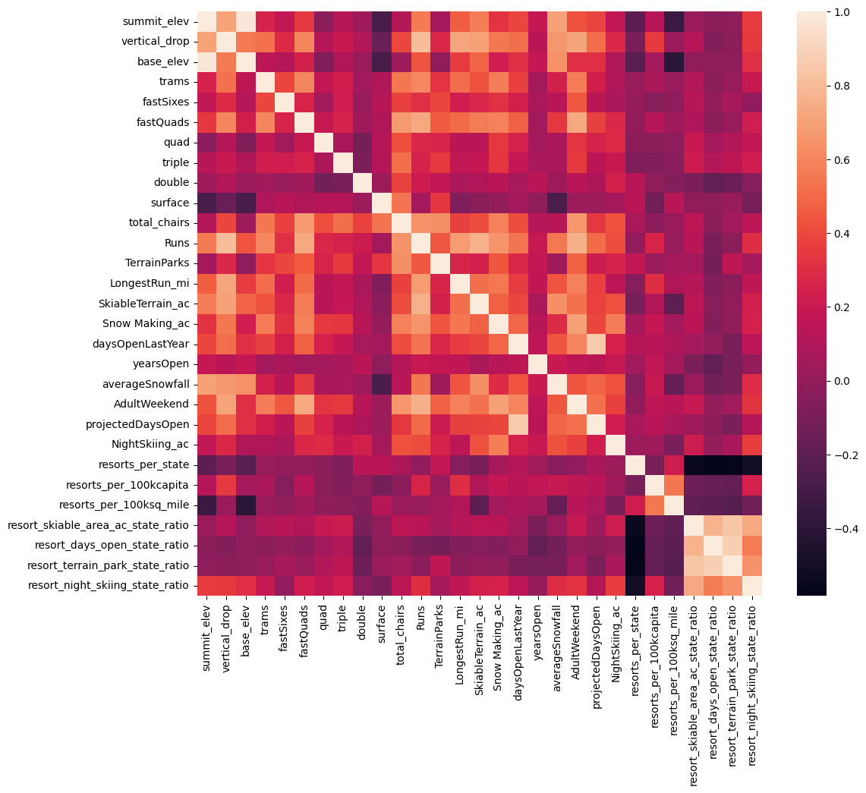
Exploratory Data Analysis
Key Insights
Larger resorts generally charged higher ticket prices
Skiable terrain, vertical drop, total chairs, and snow-making capacity showed positive relationships with ticket price
Correlation analysis identified the strongest predictors for machine learning
Figure 1. Correlation heatmap showing relationships among resort characteristics and ticket price

Slide 5
Model Evaluation & Results
Model | R² | Test MAE
Dummy Regressor | 0.00 | $19.14
Linear Regression | 0.63 | $11.79
⭐ Random Forest | 0.71 | $9.54
Why Random Forest?
Highest predictive accuracy
Lowest predictive error (MAE)
Strongest performance on unseen data
Selected as the final predictive model

Slide 6
Business Impact & Recommendation
Current Ticket Price
$81.00
↓
Model Predicted Ticket Price
$95.87
↓
Difference
+$14.97
Strategic Recommendations
Gradually increase ticket prices
Continue investing in resort improvements
Monitor customer response after pricing changes
Reassess pricing as new operational data becomes available
The Random Forest model indicates that Big Mountain may be underpriced relative to comparable resorts, creating an opportunity for gradual price increases while continuing to invest in guest experience.

Slide 7
Project Summary & Conclusion
Key Takeaways
Successfully cleaned and prepared data from 330 US ski resorts
Identified the resort features most strongly associated with weekend ticket prices
Compared multiple machine learning models and selected Random Forest ad the best performer
Demonstrated how predictive modeling can support data-driven pricing decisions
Future Opportunities
Incorporate weather and tourism demand data
Explore dynamic pricing strategies
Continuously retrain the model as new resort data becomes available
Machine learning provides ski resorts with a practical, data-driven approach to pricing decisions, helping balance customer value with long-term revenue growth.

